Slide 1
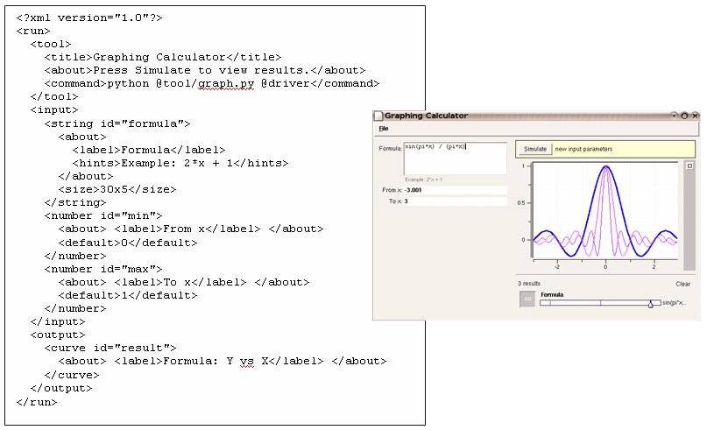

Adding Rappture to
MATLAB Applications
Derrick Kearney
HUBzero® Platform for Scientific Collaboration
Purdue University
Original slides by Michael McLennan
This work licensed under
Creative Commons
See license online:
by-nc-sa/3.0

Slide 2
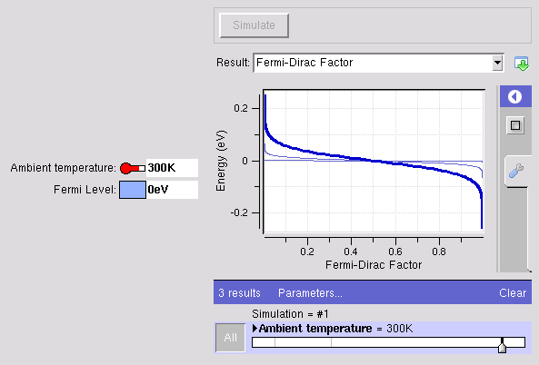
Example: Matlab/Octave Tool
The usual way…
The Rappture way…
% matlab -nodisplay -r fermi
Enter the Fermi level (eV):
Ef = 2.4
Enter the temperature (K):
T = 77
% more out.dat
FERMI-DIRAC FUNCTION F1/2
f1/2 Energy (eV)
------------ ------------
0.999955 2.33365
0.99995 2.33431
0.999944 2.33498
https://nanohub.org/infrastructure/rappture
source code: rappture/examples/app-fermi

Slide 3
What is the interface?
disp('Enter the Fermi level (eV):');
Ef = input(' Ef = ');
disp('Enter the temperature (K):');
T = input(' T = ');
kT = 8.61734e-5 * T;
Emin = Ef - 10*kT;
Emax = Ef + 10*kT;
E = linspace(Emin,Emax,200);
f = 1.0 ./ (1.0 + exp((E - Ef)/kT));
fid = fopen('out.dat','w');
fprintf(fid,'FERMI-DIRAC FUNCTION F1/2\n\n');
fprintf(fid,‘f1/2 Energy (eV)\n');
fprintf(fid,'------------ ------------\n');
fprintf(fid,'%12g %12g\n', [f; E]);
fclose(fid);
quit;
number
number
physics
curve

Slide 4
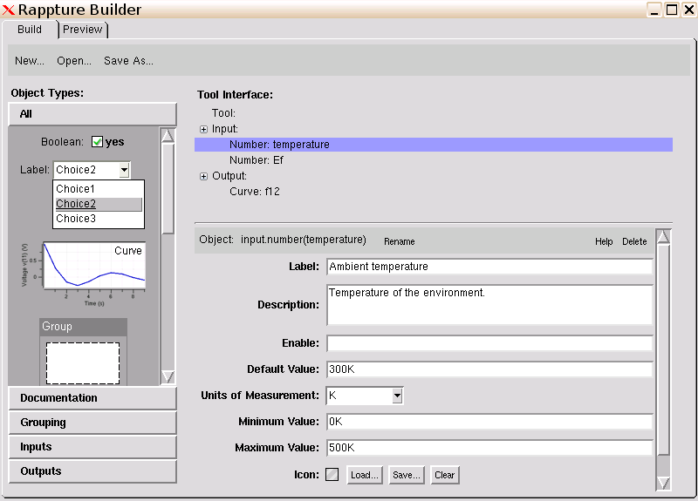
Build the interface: Temperature input
Define this input

Slide 5
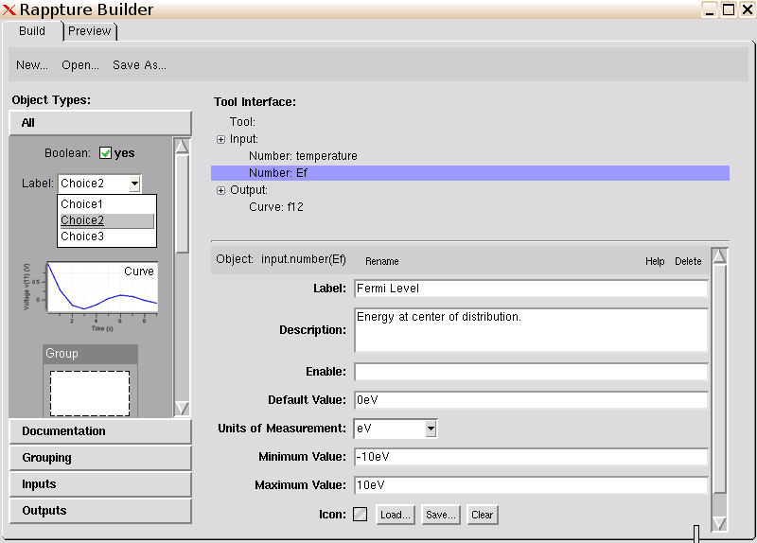
Build the interface: Ef input
Define this input

Slide 6
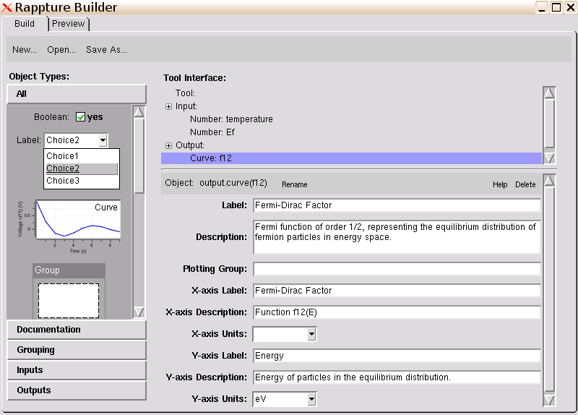
Build the interface: Curve output
Define this output

Slide 7
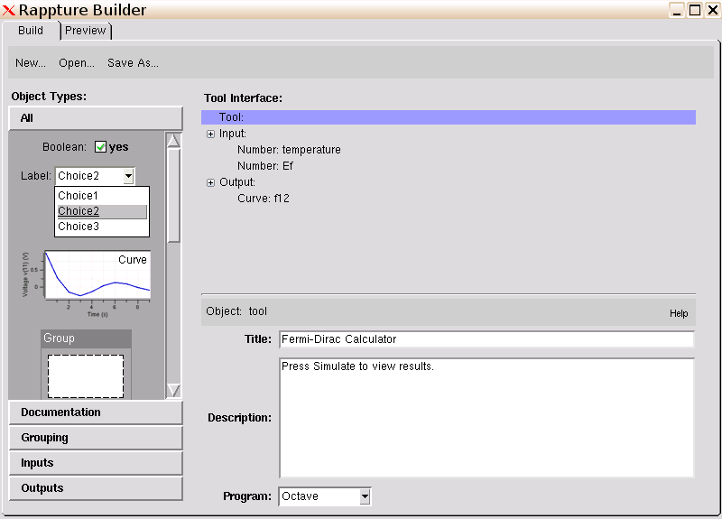
Build the interface: Use MATLAB/Octave
Define tool info

Slide 8
Add physics to the generated code
Generated script: main.m
…
% get input value for input.number(temperature) and convert to K
str = rpLibGetString(io,'input.number(temperature).current');
[temperature,err] = rpUnitsConvertDbl(str, 'K');
% get input value for input.number(Ef) and convert to eV
str = rpLibGetString(io,'input.number(Ef).current');
[Ef,err] = rpUnitsConvertDbl(str, 'eV');
%%%%%%%%%%%%%%%%%%%%%%%%%%%%%%%%%%%%
% Add your code here for the main body of your program
%%%%%%%%%%%%%%%%%%%%%%%%%%%%%%%%%%%%
%%%%%%%%%%%%%%%%%%%%%%%%%%%%%%%%%%%%
% Save output values back to Rappture
%%%%%%%%%%%%%%%%%%%%%%%%%%%%%%%%%%%%
% save output value for output.curve(f12)
% this assumes a vector 'x' and a vector 'y'
xydata = [x;y];
str = sprintf('%12g %12g\n', xydata);
rpLibPutString(io,'output.curve(f12).component.xy',str,0);
…
…
% get input value for input.number(temperature) and convert to K
str = rpLibGetString(io,'input.number(temperature).current');
[temperature,err] = rpUnitsConvertDbl(str, 'K');
% get input value for input.number(Ef) and convert to eV
str = rpLibGetString(io,'input.number(Ef).current');
[Ef,err] = rpUnitsConvertDbl(str, 'eV');
%%%%%%%%%%%%%%
% Add your code here for
%%%%%%%%%%%
%%%%%%%%%%%
% Save output values bac
%%%%%%%%%%%%%%
% save output value for output.curve(f12)
% this assumes a vector 'x' and a vector 'y'
xydata = [x;y];
str = sprintf('%12g %12g\n', xydata);
rpLibPutString(io,'output.curve(f12).component.xy',str,0);
…
kT = 8.61734e-5 * T;
Emin = Ef - 10*kT;
Emax = Ef + 10*kT;
E = linspace(Emin,Emax,200);
f = 1.0 ./ (1.0 + exp((E - Ef)/kT));
physics

Slide 9
Add physics to the generated code
Final script: main.m
…
% get input value for input.number(temperature) and convert to K
str = rpLibGetString(io,'input.number(temperature).current');
[temperature,err] = rpUnitsConvertDbl(str, 'K');
% get input value for input.number(Ef) and convert to eV
str = rpLibGetString(io,'input.number(Ef).current');
[Ef,err] = rpUnitsConvertDbl(str, 'eV');
%%%%%%%%%%%%%%%%%%%%%%%%%%%%%%%%%%%%
kT = 8.61734e-5 * temperature;
Emin = Ef - 10*kT;
Emax = Ef + 10*kT;
E = linspace(Emin,Emax,200);
f = 1.0 ./ (1.0 + exp((E - Ef)/kT));
%%%%%%%%%%%%%%%%%%%%%%%%%%%%%%%%%%%%
% save output value for output.curve(f12)
% this assumes a vector 'x' and a vector 'y'
xydata = [f;E];
str = sprintf('%12g %12g\n', xydata);
rpLibPutString(io,'output.curve(f12).component.xy',str,0);
…

Slide 10


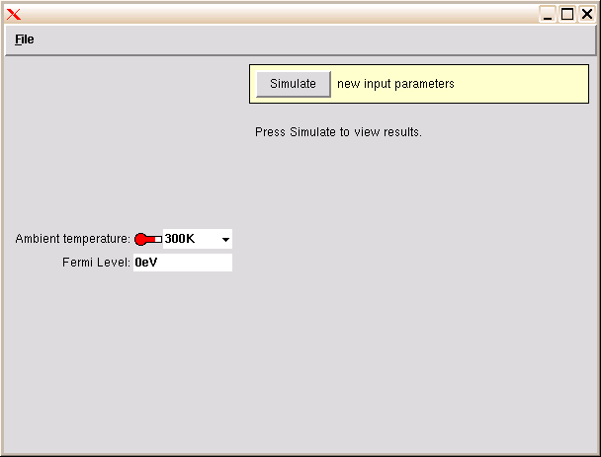
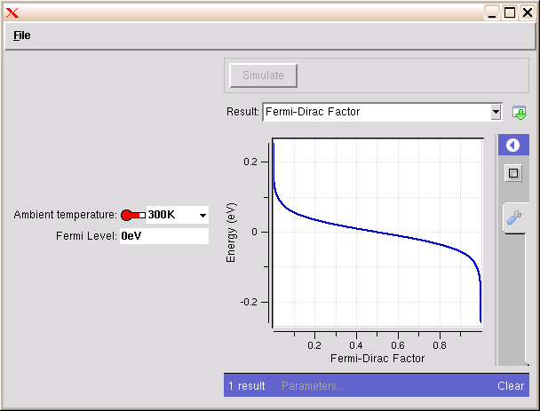
Running the code
Builder
Runner
<XML>
driver1827.xml
kT = 8.61734e-5 * temperature;
Emin = Ef - 10*kT;
Emax = Ef + 10*kT;
E = linspace(Emin,Emax,200);
f = 1.0 ./ (1.0 + exp((E - Ef)/kT));
physics
<?xml version="1.0"?>
<run>
…
<output>
<curve id="f12">
…
<component>
<xy>
0.999955 2.33365
0.99995 2.33431
0.999944 2.33498
…
</output>
</run>
<XML>
<XML>
tool.xml
run12703129102.xml

Slide 11
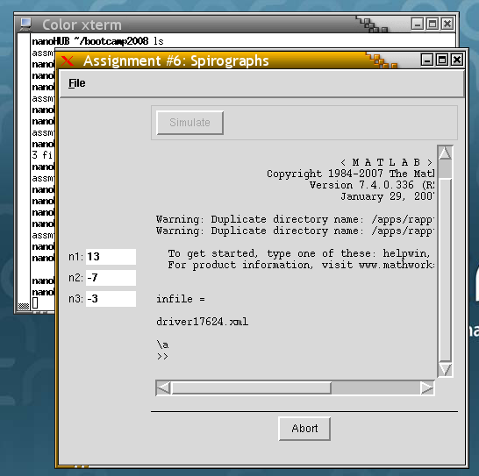


Debugging
If something goes wrong, MATLAB goes into “debug” mode:
Waiting for you to type a
MATLAB command
Click Abort instead
Run it by hand:
$ ls
driver1529.xml fermi.m tool.xml
$ use rappture
$ matlab –r infile=\’driver1529.xml\’,main

